Slide 2
Cyclic redundancy check (CRC)
In CRC, a sequence of redundant bits, called cyclic redundancy check bits, are appended to the end of data unit so that the resulting data unit becomes exactly divisible by a second, predetermined binary number.
At the destination, the incoming data unit is divided by the same number. If at this step there is no remainder, the data unit is assumed to be correct and is therefore accepted.
A remainder indicates that the data unit has been damaged in transit and therefore must be rejected.

Slide 3
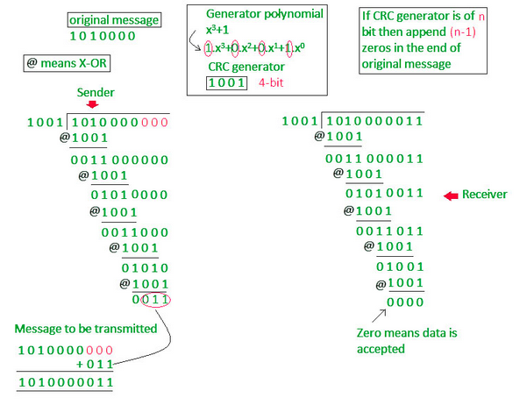

Slide 4
Hamming Code

Slide 5
A single-bit error can be detected by addition of a parity bit with the data, which needed to be send.
A single additional bit can detect error, but it’s not sufficient enough to correct that error too. For correcting an error one has to know the exact position of error, i.e. exactly which bit is in error.
For example, to correct a single-bit error in an ASCII character, the error correction must determine which one of the seven bits is in error.
(d+r) as the total number of bits, which are to be transmitted.
one value means no error, and remaining d+r values indicate error location of error in each of d+r locations.

Slide 6
d+r+1 states must be distinguishable by r bits, and r bits can indicates 2r states. Hence, 2^r must be greater than d+r+1.
2r >= d+r+1
The value of r must be determined by putting in the value of d in the relation.
For example, if d is 7, then the smallest value of r that satisfies the above relation is 4. So the total bits, which are to be transmitted is 11 bits (d+r = 7+4 =11).
Hamming code can be applied to data units of any length and uses the relationship between the data bits and redundant bits.

Slide 7
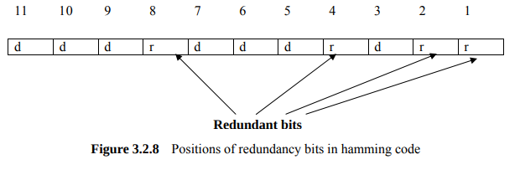

Slide 8
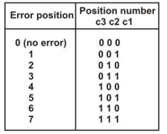

Redundant bits are palced in the powers of 2.
M = 1101

